Slide 1
MAKING YOUR DONOR MANAGEMENT SYSTEMS WORK HARDER AND BETTER

Slide 2



THANKS TO OUR SPONSORS FOR THIS SERIES!
Training Series Underwritten By:
Sponsored By:

Slide 3
WE’RE A NONPROFIT ON A MISSION TO USE TECHNOLOGY TO BETTER SERVE THE WORLD.

Slide 4



We do this by delivering tech services, education, and training that help nonprofits and communities thrive.
NONPROFIT TECH SERVICES:
Managed IT Support
Cloud Services
Strategic Consulting
Security & Compliance
Data Support
Machine Learning & AI
Community Integrated Design
WORKFORCE DEVELOPMENT:
ITWorks & CXWorks: Free IT and Customer Experience training programs
PunchCode:
12-week immersive programming bootcamp
NONPROFIT EDUCATION & TRAINING:
Reports
Consumer Guides
Assessments
Workbooks & Articles
Online Training
Free Webinars
Notes:
We deliver on our mission in several ways. Starting on the left, we offer a full-suite of nonprofit technology services including everything from Managed IT Support to Cloud Services to Data Support Services. We also create independent, thoroughly-researched technology resources for the social sector via our Idealware program. Finally, we deliver free IT and Customer experience training to young adults to help them launch their careers, and we operate an affordable coding bootcamp in Las Vegas. All of these services help nonprofits and communities thrive.

Slide 5
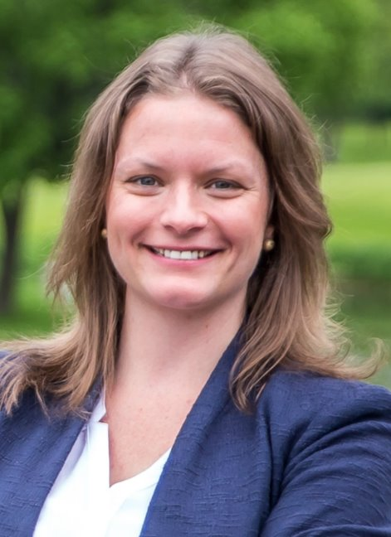
KIMBERLY SANBERG
Owner, Cairn Strategies
Pronouns: She/Her
I help nonprofits fundraise, engage supporters, build awareness, and achieve their goals with strategic digital marketing and communications, including social media, website strategy, advertising, and email.

Slide 6
AGENDA
1. Keep Your Data Tidy and Trustworthy
2. Enrich Your Understanding of Your Supporters & Prospects
3. Customize Your Donor Management System
4. Dig Into Your Data
5. Considering a New DMS?
6. Wrapping Up

Slide 7

CHALLENGES WITH DONOR DATA
Incomplete/Inaccurate data entry
Lack of master plan or documentation for the database
Data silos, data in multiple systems
Relationships e.g. households, soft credits
Reporting limitations
Notes:
Maintaining contact info – is it clean, complete [Joel said something like 20% of a mailing list will move/change contact info in a 12 month period]
Data entry isn’t consistent or isn’t done
Contact reports
EXAMPLE: Database was configured by a well-meaning VISTA years ago, lost that institutional memory, no master plan
[SARAH- VNPA got new database 2 years ago. It’s great! LGL. I’ve actually suggested LGL to clients in the past. Great scalable option. BUT… 3 Dev Dir in 2 yrs, and between Dev pros VISTA employees (who were super excited to work for a national park, maybe not so excited to do data entry) filled in the gaps.]
Householding – should you combine or not, how to do that
(two women in a household, do they get combined or separate mailing)
And other relationship tracking, e.g. soft crediting
Don’t know how to prioritize, whom to solicit or target
Useful lists (garbage in garbage out), coding

Slide 8
INTO THE CHAT
What are your challenges with donor data?
Notes:
Before we dive in, I'd like to get a better understanding of your data challenges.
Think about this broadly. What have you run up against in the past? What could be better? What data would you *love* to have that you just don't have access to? This Chat goes into the Questions pane.

Slide 9
KEEP YOUR DATA TIDY AND TRUSTWORTHY
Notes:
Having clean data is *very important*.
For example, clean data means you can:
-produce a donor list in less time
-easy to put together your annual report
- accurate targeting, which means you can make targeted asks, which means your fundraising will be more effective
- Save money by not sending multiple mailings to a married couple (One organization send me the same fundraising appeal three times -- one addressed to me, my wife, and to us as a couple)

Slide 10

START WITH DATA ENTRY STANDARDS
Set up validation rules and required fields, if your DMS has those options.
Establish guidelines for formatting.
Notes:
- A validation rule could include, for example, not allowing users to edit reconciled payments.
- Required fields can prevent errors and duplicate records.
Some databases have capability to auto-correct (standardize) and validate
There are post office standards for mailing, NCOA will return addresses in their format. Who will update the database? How often?
Include a data quality monitoring process:
Whose responsibility is this?
How often does this happen?
Formatting:
How do you treat suite numbers and apartment numbers
Do you use titles (Ms)​
How do you enter couples with different last names?
​

Slide 11

WHAT TO ENTER?
…And what to leave out?
Don’t clutter up your database with data you don’t plan to use.
Notes:
Example: At IIM they don’t necessarily create an account for people if they just join the mail list or are prospects, add them once they volunteer, donate, engage in some way. Their volunteers for Festival of Nations are not entered in the donor DB right now, because there is no clear plan to use that data, so why clutter up the DB. Another example would be a list you acquire, if people don’t respond is it worth entering them..
*But* extra data can turn out to be important. Example:
- Example: Voyageurs National Park got an exciting special project grant from Nature Valley/General Mills because they were able to pull out the constituents with relationship to General Mills.
Turns out one of their board members attends same church.
He made initial connection, which led to another connection, which led to large NEW MONEY grant. Lesson = info about relationships is important.

Slide 12
CODE DATA WITH THE END IN MIND
General Fund
Think about reporting and segmentation needs.
Don’t forget reconciliation with your accounting system.
Fall
Appeal
Spring
Event
Mail
Tickets
Online
Auction
Notes:
How to set up your campaign hierarchies and naming conventions; coding gifts and donor segments; coordinating with accounting e.g. GL codes.
Find out how your accountant is coding and match to them. And work backward from what kind of reporting and segmentation you want to do.
Track the appeal! This is how you know who you’ve asked and how they responded to you. Appeal doesn’t always mean “mailing”. Could be all of the “unsolicited” things too: brochures that sit out (in my case at a visitors center), workplace giving campaigns (ie United Way), giving pages on your website. If you track these, you’ll know where to spend your time and money.
If you don’t have time to maintain categories then don’t bother. Coding people by their source, and gifts by their source and method, is more helpful than marking a person as “mid level donor”.
POSSIBLE EXERCISE:
Write down the hierarchy of your fundraising efforts, then pick one person to share.
Example:
General Fund
-Fall appeal
-method: online, mail, etc
-Spring event
Scholarship Fund
-appeal

Slide 13

ACTIVELY MAINTAIN AND FIX PROBLEMS
Set up a routine for removing duplicates and correcting errors.
Notes:
Removing duplicates, standardizing, correcting errors, finding records with missing info, using exceptions reports
Search for inactive people who haven’t given in 5 years, mark them inactive/suppress.
Look for things like missing zip or email
Projects with no invoices
Proposal status submitted, no file attached
Tasks not marked completed

Slide 14

REMEMBER: THERE ARE PEOPLE INVOLVED
Take the software training.
Provide motivation.
Don’t be a perfectionist.
Notes:
(Might not be staff.)
Carrot and stick
Get all of your data into the same place, out of spreadsheets
Don’t be a perfectionist
Sarah inherited 35,000 5x7 cards alphabetized by name of person in whose honor/memory the gifts were given, had to just move forward, not worth entering those.

Slide 15
TO THE POLLS!
My organization does a great job keeping our data clean and updated.
              Strongly disagree
              Disagree
              Neither agree nor disagree
              Agree
              Strongly agree

Slide 16
ENRICH YOUR UNDERSTANDING OF YOUR SUPPORTERS AND PROSPECTS
Notes:
Advantages of list enhancement…

Slide 17
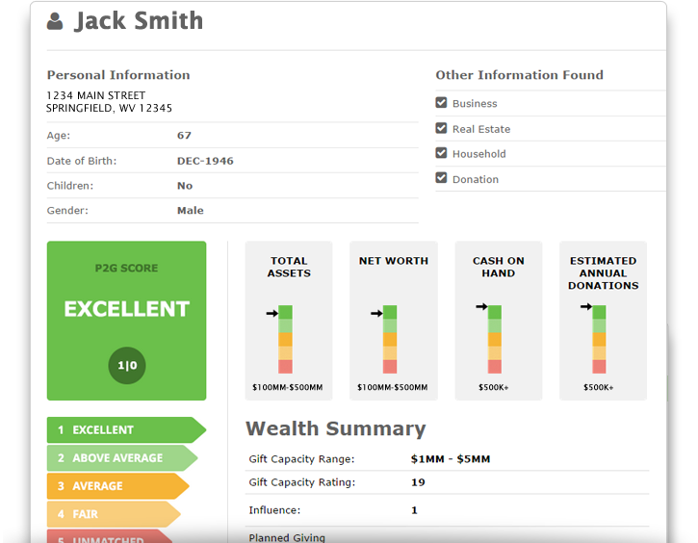
IS WEALTH DATA PRACTICAL FOR YOU?
Wealth data can reveal the capacity for a large gift.
But there might be other, more practical ways to identify those donors.
Notes:
Look at what is integrated with your DMS
Truly useful wealth data might be expensive, so maybe invest in this if you are doing a capital campaign, but not ongoing.
Instant Checkmate is an example of a subscription service where you can look up names and get contact info, some wealth info, company connections. Around $35/month (check on this).
iWave and Wealth Engine are two that are more robust on-demand tools for wealth screening plus prospect research.
Don’t expect to find a million dollar donor, but maybe a few with capacity you didn’t know about. And don’t ignore the people who give a small amount consistently—they could be prospects for an estate gift.
Taking someone out for coffee will sometimes yield more useful data than any wealth screen could.
Use this to sift donors, bring higher potential to top, then can further investigate those top potentials. You could hire a contractor, at the beginning of a major campaign, to do some deeper research on a few donors that had sifted to the top during wealth screening. Confirm hunches, give confidence to staff & volunteer solicitors.

Slide 18

EMAILS AND SOCIAL MEDIA ACCOUNTS
It costs pennies to add missing email addresses to your list.
Just make sure you have a strong opt-in process.
Notes:
Melissa.com has an affordable and reputable service for adding emails to an address list, or reverse append i.e. adding full names and postal address to an email list. They can also do social IDs and profile URLs.
Invitations/updates moving more online, even with older/traditional donors. Also, print sometimes seen by donors as waste of organizational money and non-eco-friendly.
But I do want to emphasize the opt-in piece of this. You don't want to add people to your email list without their permission, so make sure you have them opt in to receive emails from you.
Make sure you're in compliance with the CAN-SPAM Act. You have to give people the ability to opt out immediately.

Slide 19

DEMOGRAPHIC AND VOTER DATA
Vendors match your database against voter files and tell you:
Age
Gender
Race/Ethnicity
Registered to vote?
How they’re registered

Slide 20

PSYCHOGRAPHIC DATA
How could you use info about people’s interests and motivations?
How could you collect this?
Notes:
This might be more valuable than demographics, depending on your cause. Maybe a commitment to public art is the biggest factor in whether people support your organization, more important than age or income level.
You can purchase this kind of data or obtain it online if you have the sophistication to work with it.
https://infogram.com/blog/free-data-sources/
If you’re a small shop, maybe just focus on collecting this info via surveys or click tracking.
Example : hook and bullet vs tree hugger conservationists

Slide 21
INTO THE CHAT
Have you used an external service to enhance your data? Why or why not?

Slide 22
CUSTOMIZE YOUR DONOR MANAGEMENT SYSTEM
Notes:
Advantages of customization…increased productivity, insight on trends, metrics more visible, don’t overlook opportunities or tasks
This is really about making your DMS work for you.

Slide 23
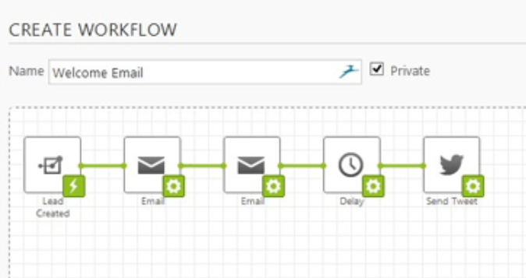
AUTOMATE TASKS USING WORKFLOW
Notes:
Could you automatically trigger a thank-you message or an alert to your ED?
For example, LGL [Little Green Light?] is built to support gift entry workflow. When setting up various campaigns/funds/appeals (which I would highly suggest doing by the time the appeal goes out) you can link an appeal to a campaign and fund.
So when you (or a well-meaning volunteer or VISTA employee) enters a gift from that appeal, it auto-fills the right campaign and fund.
It also directs you to choose the appropriate acknowledgement letter (that you have already created in your database), select any soft credits/links to other constituents, add notes, add documentation, schedule follow-up tasks.
- Other DMS don’t have all the steps built in but some like Salesforce give you options to build these or set up special data entry screens
- Also think about setting up triggers e.g. if an online gift of over $250 happens then the ED automatically gets an email message. If This Then That can sometimes do things like this. If you post to Instagram your board chair gets an alert.

Slide 24
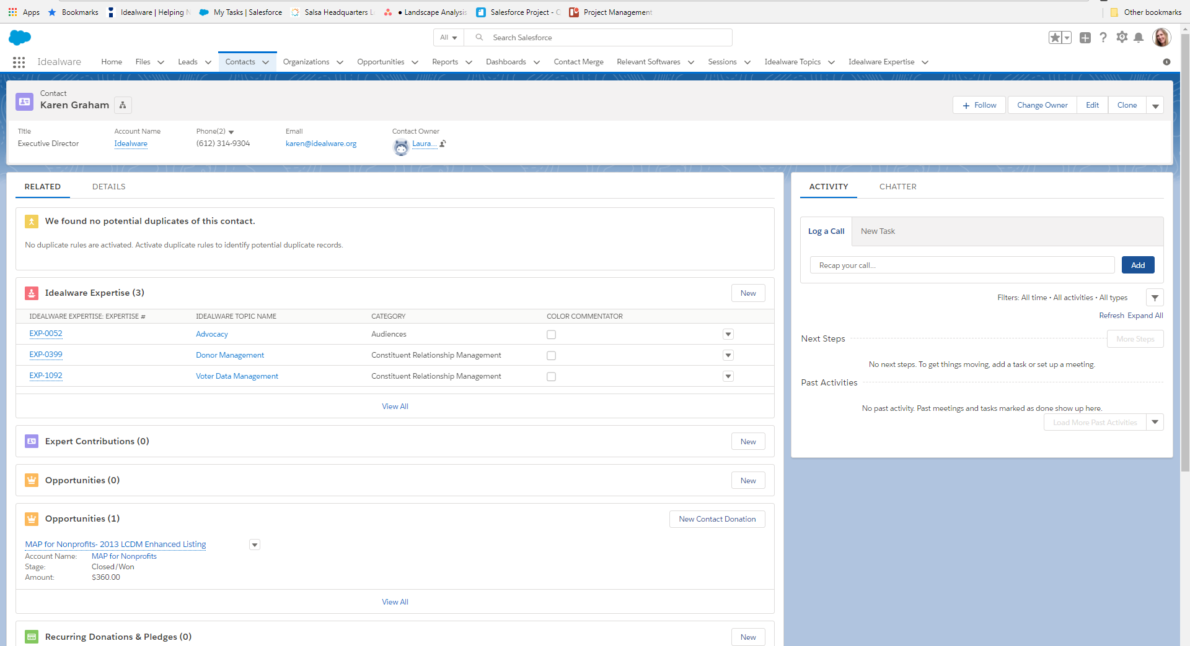
SIMPLIFY THROUGH CUSTOM PAGE VIEWS
Notes:
Check your settings, you might be able to hide unnecessary items. Bookmark your favorites.
Customize for your ED so you don’t have to keep pulling a certain report for them, simplify their view. Also protects privacy e.g. hiding credit card info.
If you don’t use certain fields, e.g. Fax Number, just hide them to avoid confusion and visual clutter.
You might be able to rearrange things on the screen so frequently used items are at the top.
Another tip: bookmark favorite records or reports in your browser.
Example: Bookmark your Today’s Tasks list, choose what order the menu items show up in and which ones get hidden, etc.

Slide 25
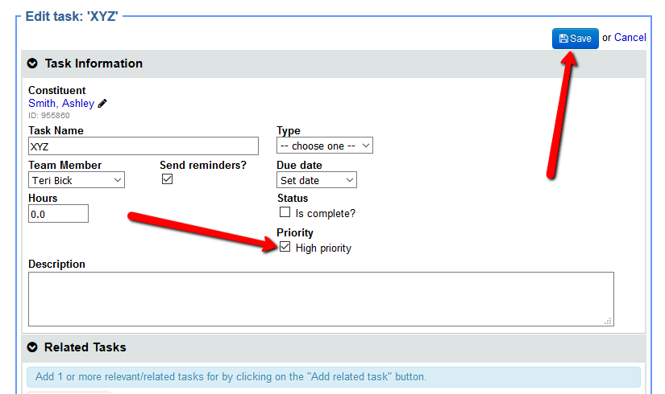
MAKE SURE YOU NEVER FORGET
Notes:
Tickler: Busy person isn’t going to remember to send a cultivation message to Chuck next month, so set it immediately after today’s meeting with him.
Choose top 10-15 and create an engagement plan. Can use your DMS or your calendar/to do list to do this. Either way, set it and forget it.
Can also assign tasks to ED, example: 12/10/2019 email Mr. Johnson re: inviting him for coffee to talk about giving us lots of money

Slide 26

A DASHBOARD HELPS YOU MONITOR
Define key metrics first.
Then set up a visual dashboard to see at a glance whether or not you are on track.
Notes:
Overall engagement and relationships
-I’ve had 35 visits this quarter
-50% of our donors also volunteered this year
How much did we raise
What activities are working

Slide 27
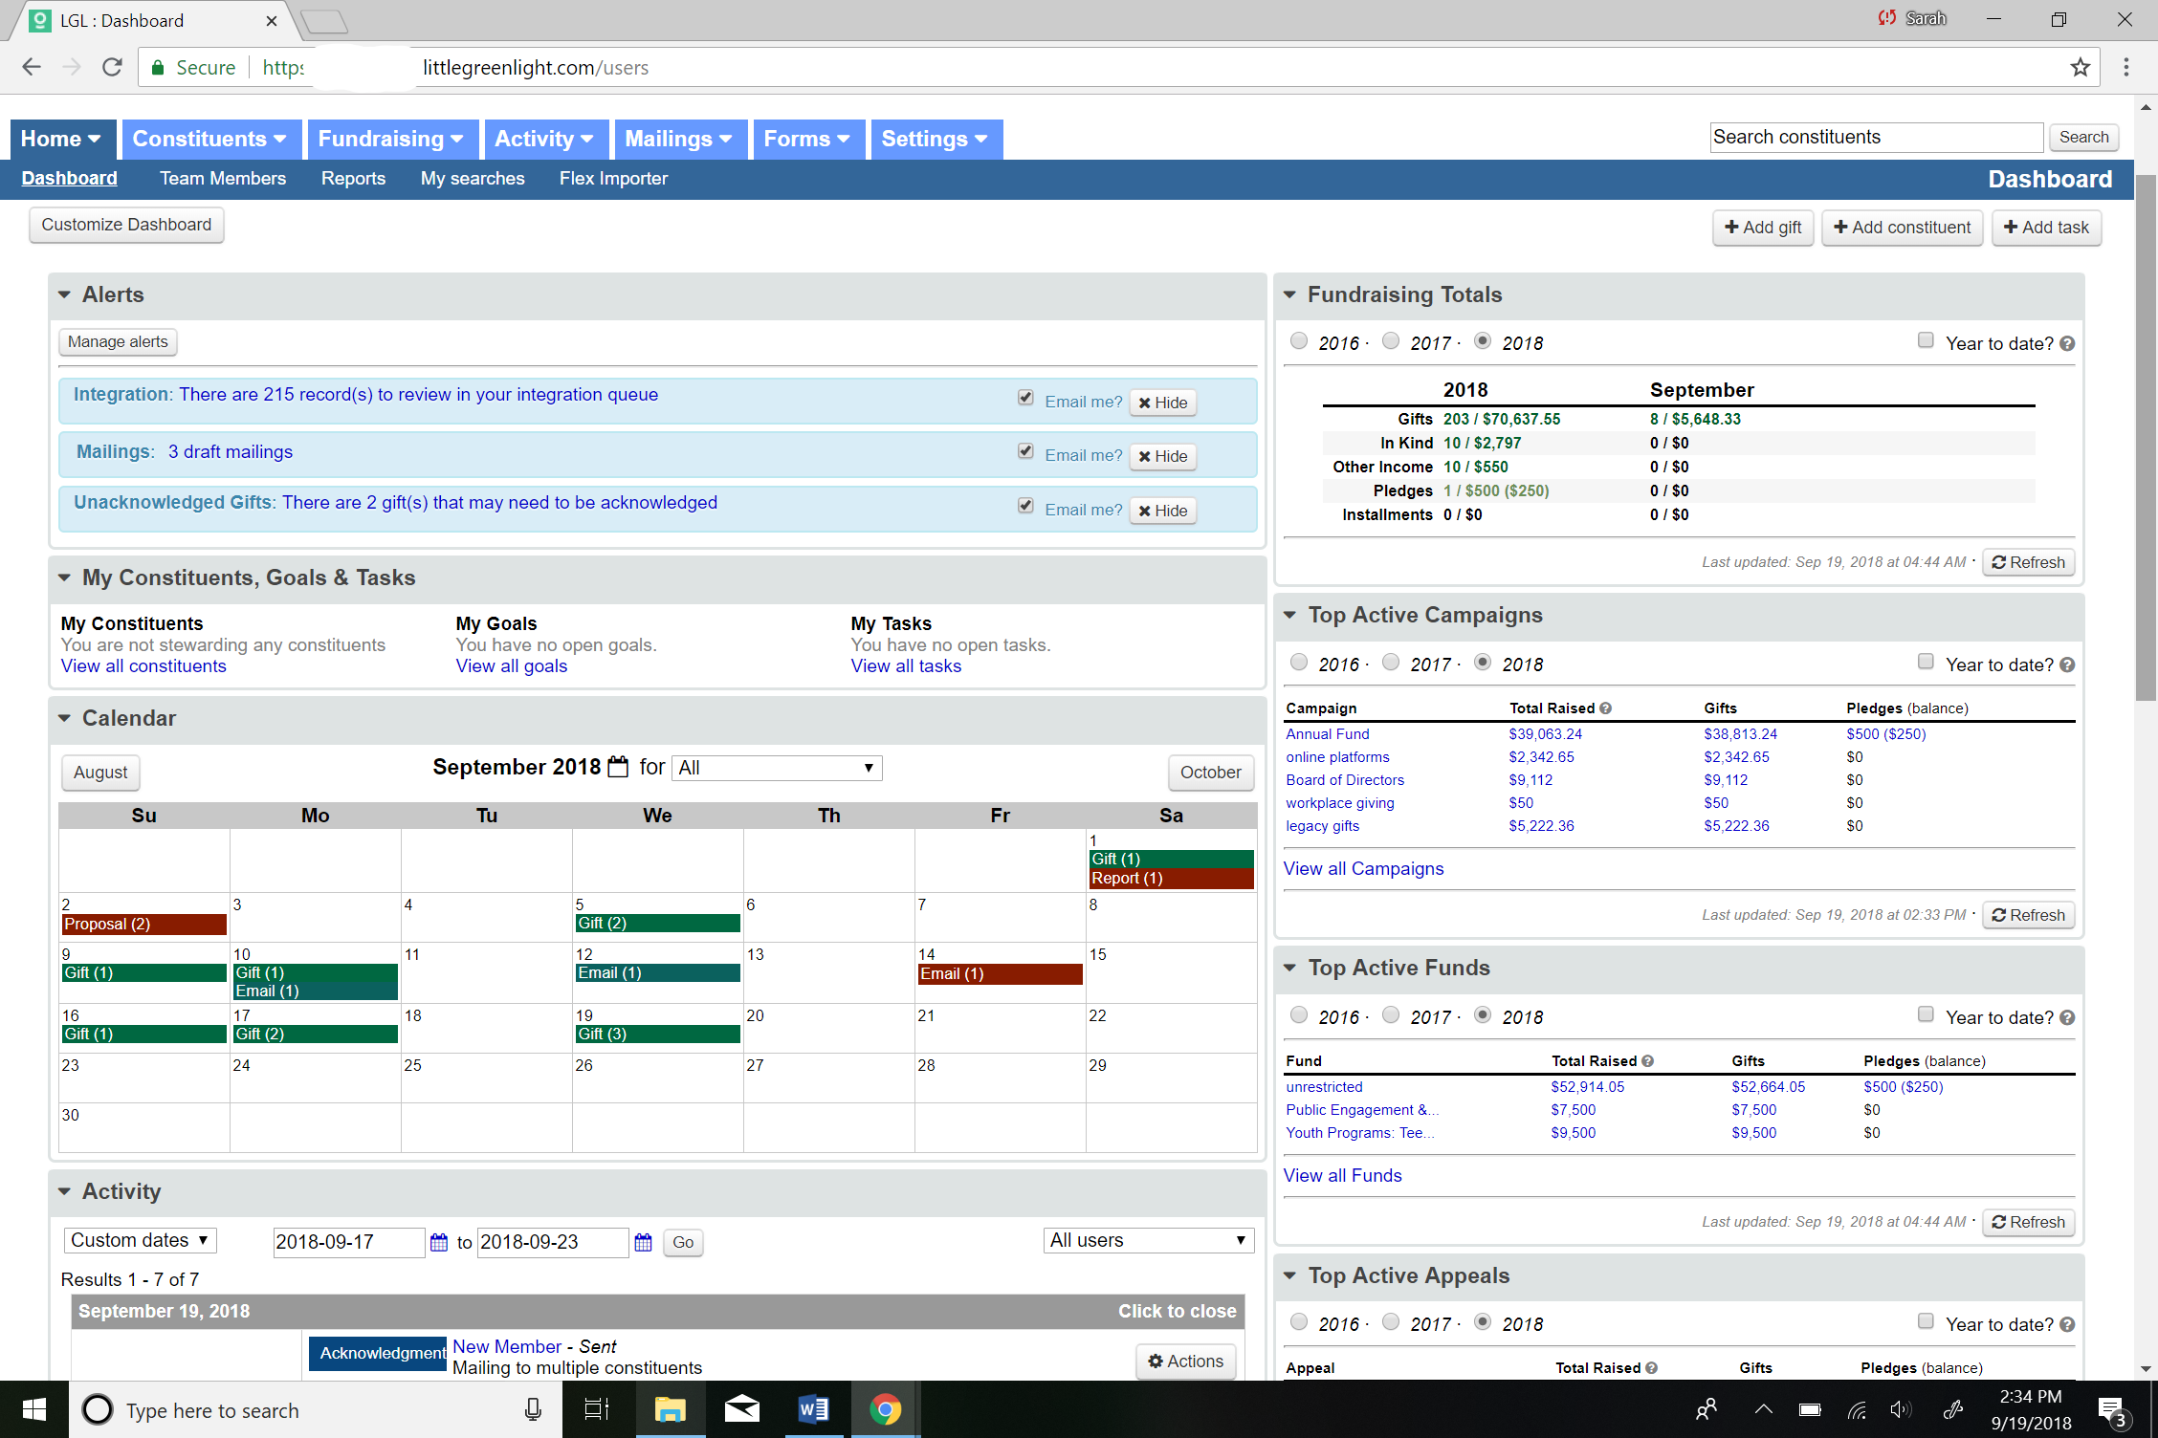
Notes:
Here's an example of what your dashboard might look like.
At a glance, this looks overwhelming – but the goal is to customize it and make it really helpful for you.
It can take a little bit of time to get it set up, but it's well worth taking an extra hour to make it work well for you. It will save you a lot of time and effort in the long tun.

Slide 28
WHAT ARE SOME FUNDRAISING METRICS YOU MAY WISH TO TRACK?
Total fundraising
Revenue broken down by fundraising strategy
Revenue broken down within strategies by specific appeals
Current members; lapsed members
Renewal rate/retention rate
Number of donor meetings you’ve conducted
Notes:
- These are just examples. You might want to prioritize all of these, or none of them and something completely different.

Slide 29
TO THE POLLS!
Which of the following best describes your organization?
Our DMS is inflexible so we have little ability to customize it.
Our DMS is flexible, but we don't understand how to customize it.
Our DMS is flexible, but we lack the time needed to customize it.
Our DMS is flexible, and we're customizing it to match our needs.

Slide 30
DIG INTO YOUR DATA
Notes:
Now, this is the really fun part. Here's where all of your work setting up your DMS and actively managing it can pay off.
Analysis and segmentation of your data can really help you optimize your fundraising.

Slide 31


USE DATA TO FORECAST AND SET GOALS
What can the past tell you about the future?
Notes:
LYBNT, SYBNT reports can be really helpful
This time last year how much had we raised or how much had individuals given –
LYBUNT/SYBUNT reports, including YTD
Percentage of donors who respond to mail, email
Average gifts not as useful as gift ranges (scatter plot)
Monthly giving trend – predict when gifts are coming in based on gifts in past years. Then run regular report on gifts expected and not yet received. Makes it easier to follow-up/remind donors to make their annual gift/membership
Donor pyramid (how many donors give/gave at various levels)
How many asks did it take to get to $xxxx last year

Slide 32

USE DATA TO MAKE COURSE CORRECTIONS
Data tells you where to focus your energy and how to calibrate your efforts.
Notes:
Donor pyramid – look at which levels are strongest, and use that to prioritize sending another email message vs making calls or visits to higher level donors.
Progress toward goals
If a mailing flopped, and you are tracking response rates, you will know pretty quickly—so take action right away to correct that.

Slide 33

USE DATA TO EVALUATE RESULTS
Was that gala event worthwhile? How do you know?
Notes:
Response rates
How many appeals did you send, how many responses, how many were new gifts, etc
You might need data to justify what you are doing and how you spend your time. Keep up with your contact reports. They don’t have to be fancy, just tracked in a way that you can say “Dear Board Chair Bob, we had contact with 211 donors/prospects this month.”
Tracking appeals can also help answer these questions: Why do we need to spend more money on technology? Because 42.5% of our contributed revenue come in online.
Why are we not going to mail appeals 6 times a year anymore? Because 4 of them have a negative ROI. (Note: If someone always gives online –for years- and hasn’t responded to a mailing since 2008, it might be time to rethink how much you’re spending to mail stuff to that person. Maybe a “your annual support means a lot to Fluffy the Cat (pictured here) and all of your friends here at Adopt-a-Cat.org” on a postcard rather than the full appeal package (that they’re probably not even opening before recycling it).
For something like a gala, you might get more sophisticated than just tracking total income vs total expense. Set up ways to track how many people were introduced to the organization this way, and whether the average gift of a gala donor is more or less than the average gift from other sources. Are gala donors loyal, repeat donors? Etc.

Slide 34

SEGMENTATION CAN BOOST RESULTS
Instead of sending everyone the same message, try tailoring it to the type of relationship they have with your organization, or their interests.
Notes:
Donors support you for different reasons, make a different case. Gateway Businesses = tourism, Other businesses = conservation, Other helpful groups: Board members, committed volunteers, social groups (women paddlers, chapter memberships, etc), interests (fishing, hunting, photography, kids, specific subjects) – anything that allows for EASY segmentation.
Gift amount is tricky because the significance of a $100 gift can vary a lot to individuals.
If you are only going to segment one way, do it based on relationship to org, e.g. companies, members, volunteers.
Once you've segmented your list, you can send different segments different messages and/or different asks that are targeted to them, specifically, based on your data. Doing that will make your fundraising more effective.
- For example, say you're an environmental organization that two main programs -- dedicated to educating kids, and one dedicated to educating the public about environmental health. If you have a donor who gave you $5,000 last year and you know is passionate about your children's education program, you wouldn't want to send them an appeal all about environmental health and then have the ask be $250.

Slide 35

EXTRA CREDIT: A/B TESTING (IT’S NOT THAT HARD)
Try testing an email subject line:
10% get version A
10% get version B
80% get the winner
Notes:
If you have any more than about 1,000 people it’s worthwhile
Simple example: email subject lines, 10% gets version A, 10% gets version B, 80% got the winner. With subject line the winner would be determined by open rate.
Doesn’t have to be truly random, just sort them somehow.
Example: Voyageurs NP tested different kids of images. Loon mama w/babies on her back did better than expected. Kids jumping off dock didn’t do as well as expected. Aurora won.

Slide 36
INTO THE CHAT
Is your organization good about using data to evaluate the success of past appeals or events? If not, why not?

Slide 37
CONSIDERING A NEW DMS?

Slide 38
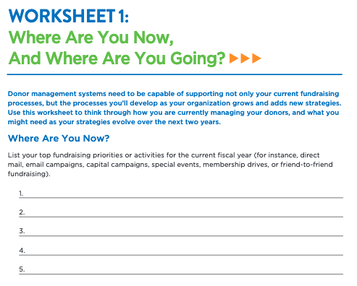
Notes:
On the course page, you'll find a series of worksheets that will help you think through the best way to approach finding a new DMS.
You really don't want to rush into this, so I highly recommend taking the time to think through everything you need. These worksheets will help you do that.

Slide 39
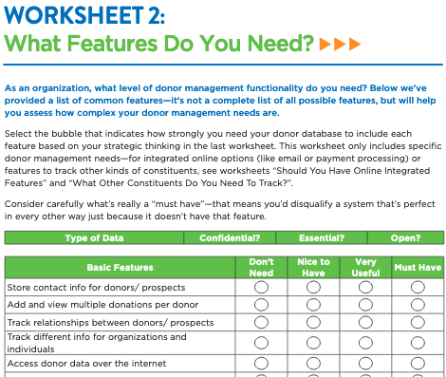
Notes:
I just want to give you a preview of the worksheets so you know what to expect.

Slide 40
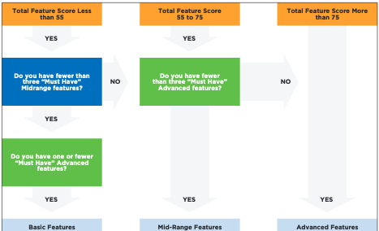
Notes:
There's even a decision tree that will help you decide which direction is right for you.

Slide 41
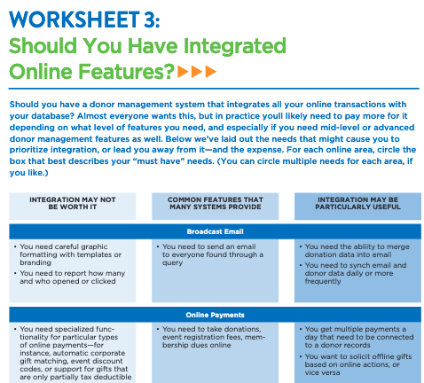
Notes:
The worksheets will also help you think through integration, which is a very important consideration.

Slide 42
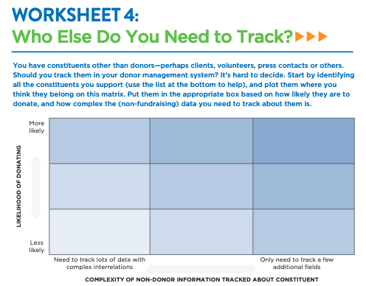
Notes:
This matrix will help you decide who – beyond donors – you should track in your DMS.

Slide 43
WRAPPING UP

Slide 44

THINK OF A FUNDRAISING GOAL YOU HAVE…

Slide 45
HOW COULD YOUR DMS HELP YOU REACH THAT GOAL?
Data entry standards
Coding
Fixing Problems
Training and Motivating Staff
Appending Wealth Data
Appending Email and Social Media Data
Workflows
Custom Views
Tasks and Prompts
Dashboards
Data Analysis
Segmentation
A/B Testing
Notes:
Review Learning Goals:
Understand how clean data helps you and learn tips to keep it clean
Discover options for list enhancement and how to put that to use
Explore how customization might improve your productivity
Learn to use data analysis and segmentation to forecast and improve results
Did we accomplish this?

Slide 46

START WITH SMALL STEPS
What can you do this week?
Notes:
Go around the room and state intentions.

Slide 47
ADDITIONAL RESOURCES
A Consumers Guide to Low-Cost Donor Management Systems
Peer-to-Peer Fundraising Made Easy: A Step-by-Step Workbook
Nonprofit Best Practices: Online Donation Appeals
Becoming a Data-Informed Organization: How to Assess Your Nonprofit’s Data Maturity and Create a Culture of Continuous Improvement
You can find these resources, the webinar recording, and slide deck for this and past webinars at:
https://offers.techimpact.org/course-page-nycon
Notes:
We'll link to all of these on the course page, too.

Slide 48
THANK YOU!
Notes:
Amy
TAG
Funders of the series?

